Slide 1
BANK LOAN ANALYSIS
PROJECT
USING SQL AND EXCEL

Slide 2
INTRODUCTION
This project focuses on analyzing bank loan data to provide meaningful insights into loan applications and their performance. By utilizing SQL and Excel, the analysis uncovers key metrics such as the total number of loan applications, total funded amounts, amounts received, average interest rates, and the average debt-to-income ratio (DTI). A detailed dashboard has been created to visually represent these insights, making it easier to identify trends and patterns. This project not only helps in understanding the overall loan distribution and repayment dynamics but also serves as a practical demonstration of data analysis skills using SQL and Excel. It aims to showcase how data-driven decisions can optimize loan management processes effectively.

Slide 3
PROBLEM STATEMENT
DASHBOARD 1: SUMMARY
Key Performance Indicators (KPIs) Requirements:
Total Loan Applications: We need to calculate the total number of loan applications received during a specified period. Additionally, it is essential to monitor the Month-to-Date (MTD) Loan Applications and track changes Month-over-Month (MoM).
Total Funded Amount: Understanding the total amount of funds disbursed as loans is crucial. We also want to keep an eye on the MTD Total Funded Amount and analyse the Month-over-Month (MoM) changes in this metric.
Total Amount Received: Tracking the total amount received from borrowers is essential for assessing the bank's cash flow and loan repayment. We should analyse the Month-to-Date (MTD) Total Amount Received and observe the Month-over-Month (MoM) changes.
Average Interest Rate: Calculating the average interest rate across all loans, MTD, and monitoring the Month-over-Month (MoM) variations in interest rates will provide insights into our lending portfolio's overall cost.
Average Debt-to-Income Ratio (DTI): Evaluating the average DTI for our borrowers helps us gauge their financial health. We need to compute the average DTI for all loans, MTD, and track Month-over-Month (MoM) fluctuations.

Slide 4
PROBLEM STATEMENT
DASHBOARD 1: SUMMARY
Good Loan vs Bad Loan KPI’s
Good Loan:
Good Loan Application Percentage
Good Loan Applications
Good Loan Funded Amount
Good Loan Total Received Amount
Bad Loan:
Bad Loan Application Percentage
Bad Loan Applications
Bad Loan Funded Amount
Bad Loan Total Received Amount
Loan Status Grid View
To gain a comprehensive understanding of our lending operations and evaluate loan performance, we are developing a grid view report categorized by 'Loan Status.' This report will provide key insights into metrics such as 'Total Loan Applications,' 'Total Funded Amount,' 'Total Amount Received,' 'Month-to-Date (MTD) Funded Amount,' 'MTD Amount Received,' 'Average Interest Rate,' and 'Average Debt-to-Income Ratio (DTI).' By leveraging these insights, the grid view will enable us to monitor the health of our loan portfolio and support data-driven decision-making with greater precision and clarity.

Slide 5
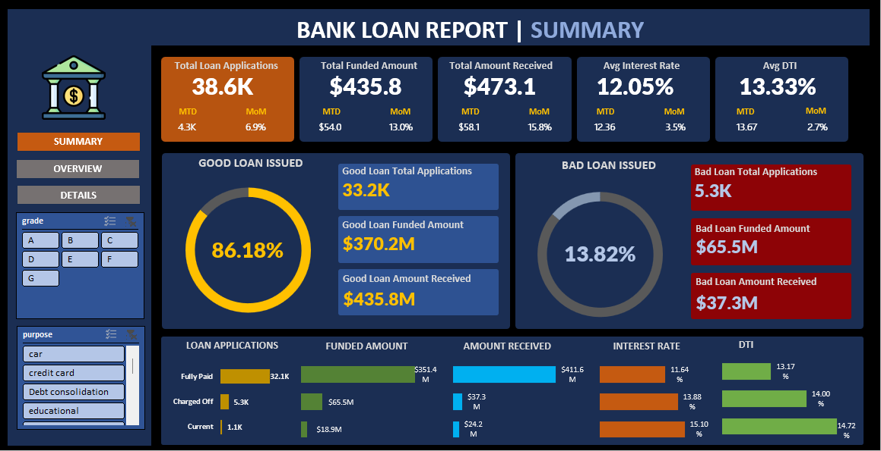
SUMMARY DASHBOARD

Slide 6
PROBLEM STATEMENT
DASHBOARD 2: OVERVIEW
CHARTS
Monthly Trends by Issue Date (Line Chart): To identify seasonality and long-term trends in lending activities
Regional Analysis by State (Filled Map): To identify regions with significant lending activity and assess regional disparities
Loan Term Analysis (Donut Chart): To allow the client to understand the distribution of loans across various term lengths.
Employee Length Analysis (Bar Chart): How lending metrics are distributed among borrowers with different employment lengths, helping us assess the impact of employment history on loan applications.
Loan Purpose Breakdown (Bar Chart): Will provide a visual breakdown of loan metrics based on the stated purposes of loans, aiding in the understanding of the primary reasons borrowers seek financing.
Home Ownership Analysis (Tree Map): For a hierarchical view of how home ownership impacts loan applications and disbursements.

Slide 7
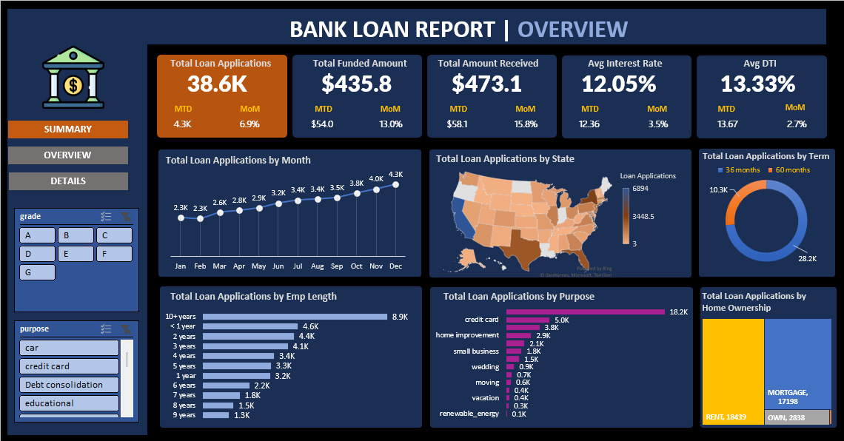
OVERVIEW DASHBOARD

Slide 8
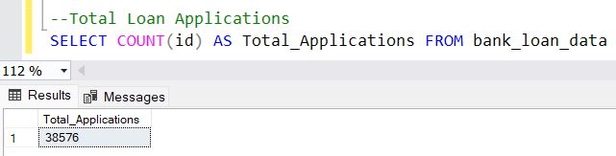
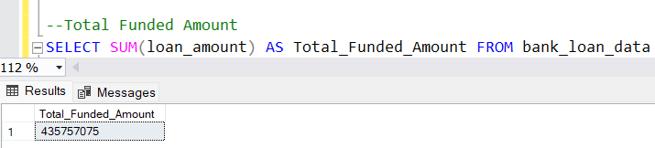
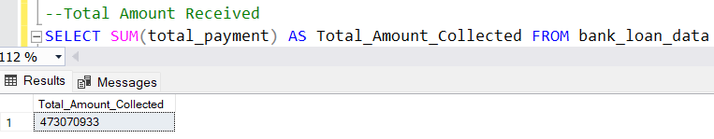
Key SQL Queries and Insights
Total Loan Applications:
Total Funded Amount:
Total Amount Received:
Here are a few key SQL queries showcasing the analysis. For the complete set of queries, please refer to the PDF document linked below.
Sql_queries_document

Slide 9
FINDINGS
Debt-to-Income Ratio (DTI): The average DTI is 13.32%, highlighting borrowers' ability to manage debt relative to their income.
Key Highlights
Good Loan vs. Bad Loan: The analysis revealed that 86% of loans are Good Loans, while 13.8% are Bad Loans.
Purpose of Loans: We identified the primary reasons why people apply for loans, providing valuable insights into customer needs.
Debt-to-Income Ratio (DTI): The average DTI is 13.32%, highlighting borrowers' ability to manage debt relative to their income.
Average Interest Rate: The average interest rate across loans is 12%, offering insights into the cost of borrowing.
Recommendations
Enhance Risk Management: Focus on reducing the percentage of Bad Loans by refining credit assessment criteria and improving borrower screening.
Customer-Centric Loan Products: Leverage insights on loan purposes to design customized loan products that align with customer needs.
Monitor DTI Trends: Keep a close watch on the Debt-to-Income Ratio to ensure borrowers remain within sustainable debt levels.
Optimize Interest Rates: Evaluate the current interest rates and consider offering competitive rates for Good Loan customers to retain loyalty and attract more borrowers.

Slide 10
CONCLUSION
In conclusion, this project provided valuable insights into the bank's loan portfolio, offering a clear understanding of key metrics such as loan performance, borrower behavior, and financial health. The findings reveal that 86% of loans are classified as Good Loans, reflecting strong creditworthiness and effective lending practices—a highly encouraging sign for the bank’s operations. Additionally, insights into borrower trends, such as the average Debt-to-Income Ratio (13.32%) and average Interest Rate (12%), provide further confidence in the stability of the loan portfolio.
While the overall performance is commendable, there is an opportunity to reduce the 13.8% of Bad Loans through enhanced credit evaluation methods and risk management strategies. By refining these processes and offering tailored loan products aligned with borrower needs, the bank can minimize risks, attract more reliable customers, and strengthen its market position.
These actionable insights, combined with a focus on continuous improvement, will pave the way for sustained growth and success in the bank's lending operations.

Slide 11

Thank you

